Slide 1
DETECTING EYE DISEASES
With Computer Vision
By: Zuleyka, Jose, & Lidzy

Slide 2
TABLE OF CONTENTS
01
02
03
04
05
06
OUR GOAL
THE DATASET
PATHOLOGY
Project purpose and importance.
Dataset details and handling.
Eye disease overview.
BUILDING MODEL
PERFORMANCE
CONCLUSION
Results and accuracy.
Summary and future steps.
Model creation steps.

Slide 3
01
OUR GOAL

Slide 4
WHY?
Why Early Detection Matters:
Millions suffer from preventable vision loss due to late detection of eye diseases.
In remote or underserved areas, specialists are few and far between.
Solution:
Automatic early screening using machine learning to flag potential problems quickly.
Why CNN Models?
CNN models are highly effective at detecting visual patterns in images from Color Fundus Photography. They can recognize important signs of eye diseases—such as swelling, lipid deposits, and scars—enabling accurate identification and diagnosis of specific conditions.
Notes:
Color fundus photography is a non-invasive way to take a color picture of the back of your eye (the retina).

Slide 5
RESEARCH QUESTIONS
1.
How accurately can a CNN classify different eye diseases from retinal images?
2.
How much does preprocessing (resizing, balancing) improve the CNN’s performance?
3.
Which diseases does the CNN struggle or excel at identifying?
PROJECT GOAL
Develop a CNN to accurately classify multiple eye diseases from retinal images, exploring key challenges in medical image analysis.

Slide 6
02
THE DATASET

Slide 7
DATA OVERVIEW
01
IMAGES
Total images: 16,242
80% Training (12,994 images)
10% Validation (1,624 images)
10% Test (1,624 images)
Re-sized to 128x128 pixels for faster processing.
02
CLASSES
Categorized into ten classes: Diabetic Retinopathy, Glaucoma, Macular Scar, Optic Disc Edema, Central Serous Chorioretinopathy (CSCR), Retinal Detachment, Retinitis Pigmentosa, Myopia, Pterygium, and Healthy.
03
IMBALANCE
The dataset was imbalanced—some diseases had many images, others very few. We addressed this by oversampling minority classes.

Slide 8
03
PATHOLOGY

Slide 9
EYE DISEASE CLASSES
0 | Central Serous Chorioretinopathy | Fluid buildup beneath the retina causing blurred or distorted vision.
1 | Diabetic Retinopathy | Damage to blood vessels in the retina caused by diabetes.
2 | Disc Edema | Swelling of the optic nerve, often from increased pressure or inflammation.
3 | Glaucoma | Damage to the optic nerve, often related to high eye pressure.
4 | Healthy | Normal retina without signs of disease.
5 | Macular Scar | Scarring on the macula (center of retina), causing central vision loss.
6 | Myopia | Nearsightedness where distant object appear blurry.
7 | Pterygium | Growth of tissue on the white part of the eye that may affect vision.
8 | Retinal Detachment | Separation of retina from underlying tissue, causing sudden or gradual vision loss.
9 | Retinitis Pigmentosa | Inherited disease causing progressive loss of night vision and peripheral sight.

Slide 10
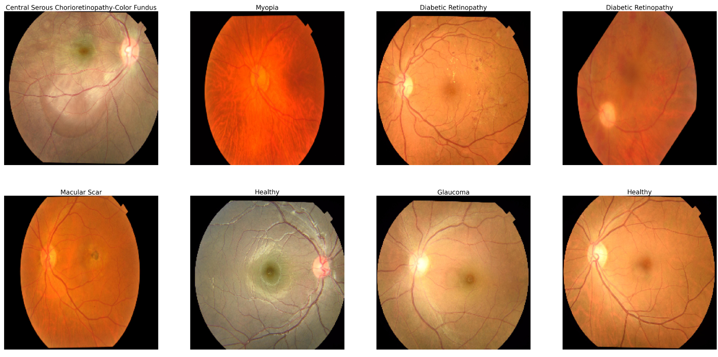

Slide 11
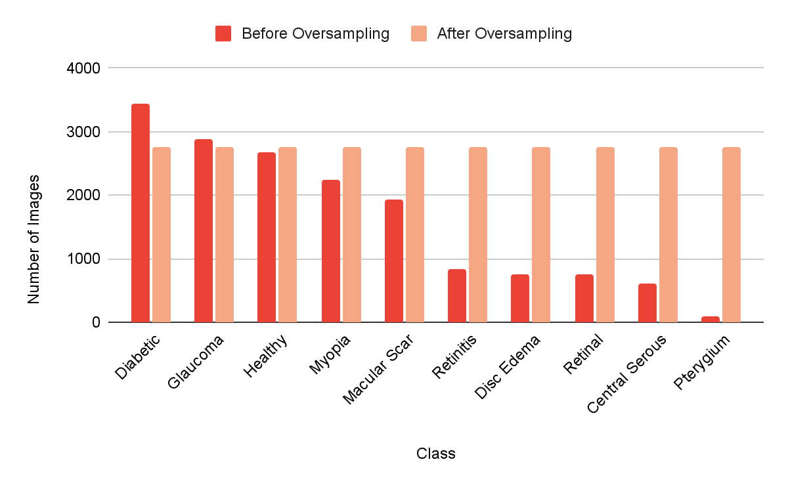
IMAGES PER EYE DISEASE CLASS
Class Distribution
Majority Class
Diabetic Retinopathy had the most images, which became the oversampling target for minority classes.
Oversampling
Benefit: Ensures the CNN learns evenly across classes, reducing bias towards more common diseases.
Risk: Potential overfitting – the model could memorize duplicate images, affecting performance on new real-world cases.

Slide 12
04
BUILDING THE CNN MODEL

Slide 13
BUILDING THE CNN MODEL
01
02
03
04
PREPROCESSING
HYPERPARAMETERS
Prepping the data for model.
Setting model settings like learning rate, batch size, and epochs.
TRAINING
DEFINING
Teaching the CNN to recognize patterns by showing it many images.
Dissecting the model’s layers and their respective functions.

Slide 14
DATA PREPROCESSING (⅓)
Created a Dataframe from Images:
We organized the image data into a Pandas DataFrame for easier management. Each row includes:
Image location (path)
Corresponding disease label (class)
We store this information in a Pandas Dataframe, like a table, so the model knows what each image is and where to find it during training.
Let’s look at what this dataframe looks like.

Slide 15
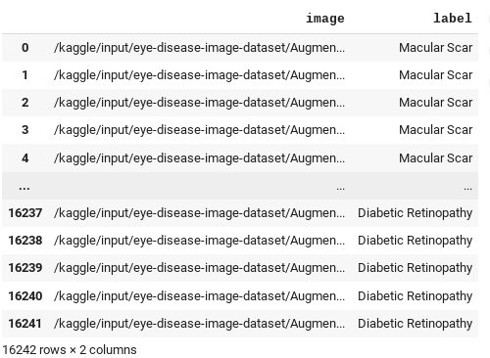
PATH
CLASS

Slide 16
DATA PREPROCESSING (⅔)
2. Resized Images:
We resize all images to 128×128 pixels to make sure they are the same size.
This step helps the CNN model because:
It reduces memory usage and speeds up training.
It keeps the input format consistent, which the model needs.
Without resizing, the model would struggle to process images of different shapes and sizes during training.

Slide 17
DATA PREPROCESSING (3/3)
3. Normalized color values:
We normalized the Red, Green, and Blue (RGB) values of each pixel to make them smaller and balanced.
This step helps the CNN model because:
It speeds up learning by keeping numbers close to 0 (e.g., between -1 and 1) instead of between 0 and 255.
It makes training more stable and prevents very large or very small values from confusing the model.
The images stayed in full color — they just became easier for the model to understand!

Slide 18
transform = transforms.Compose([
transforms.Resize((128, 128)),
transforms.ToTensor(),
transforms.Normalize(
mean=[0.485, 0.456, 0.406],
std=[0.229, 0.224, 0.225]
)
])
# Resizes all images to 128x128 pixels
# Converts images to tensors
# Normalizes RGB color values
Notes:
Subtract the mean: shifts each color channel so its average becomes 0—this centers the data.
Divide by the standard deviation: scales each channel so its values spread out with a standard deviation of 1—this makes all channels equally “important” to learn from.

Slide 19
2. HYPERPARAMETERS
Set hyperparameters:
Hyperparameters are like settings we choose before training the model. They control how the model learns.
We set important hyperparameters:
Learning rate — how big the model’s learning steps are (we used 0.001).
Batch size — how many images the model sees at once (32 images per batch).
Epochs — how many times the model sees the whole dataset (10 times).
Choosing good hyperparameters helps the model learn faster and make better predictions!
Notes:
Why 0.001? It’s small enough to avoid overshooting the minimum yet large enough to learn quickly.
Batch size of 32 a common “sweet spot” because:
It’s small enough to fit in GPU memory easily.
It’s large enough to give a stable estimate of the gradient (so training is smooth).
The gradient is the “slope” of your model’s error (loss) with respect to its weights.

Slide 20
criterion = nn.CrossEntropyLoss()
optimizer = optim.Adam(model.parameters(), lr=0.001) # Learning rate = 0.001
train_loader = DataLoader(train_data, batch_size=32, shuffle=True)
# Batch size = 32
train_model(model, train_loader, val_loader, epochs=10) # Epochs = 10
# Loss function (used to measure error)
# Optimizer with learning rate
# Data Loader with batch size
# Training for a set number of epochs

Slide 21
3. TRAINING
Training Steps:
Show images to the model (in batches).
Make predictions (the model guesses the class).
Calculate the loss (how wrong the prediction was).
Adjust the weights and bias using the optimizer (make the model better).
Repeat this process for 10 epochs until the model improves.

Slide 22
4. DEFINING (1/3)
Breaking Down Layer Progression:
Techniques: Conv2D (32 filters) + ReLU + MaxPooling
Layer #1. Basic Edges
Input Layer:
Accepts resized images of 128x128x3 (RGB)
First Convolutional Layer:
32 filters (Conv2D)-a power of 2ⁿ is commonly used in CNNs to efficiently scale memory and computation.
Detects basic features like simple edges and color gradients
ReLU activation introduces non-linearity
First MaxPooling Layer:
Reduces feature map size to focus only on the most important low-level features.

Slide 23
4. DEFINING (2/3)
Breaking Down Layer Progression:
Techniques: Conv2D (64 filters) + ReLU + MaxPooling
Layer #2. Textures & Shapes
Second Convolutional Layer:
64 filters (Conv2D)
Captures more complex textures and shapes (like curves, blobs, vessels).
ReLU activation keeps model flexible to non-linear patterns.
Second MaxPooling Layer:
Further down samples to retain essential texture and shape features.

Slide 24
4. DEFINING (3/3)
Breaking Down Layer Progression:
Techniques: Conv2D (128 filters) + ReLU + MaxPooling + Flatten + Dense + Softmax
Layer #3. Full Patterns
Third Convolutional Layer:
128 filters (Conv2D)
Learns full complex patterns like full lesion shapes, scar outlines, etc.
Third MaxPooling Layer:
Reduces over-complexity while preserving important global patterns.
Flatten Layer:
Converts extracted 2D feature maps into a 1D feature vector for classification.
Dense Layer
128 neurons with ReLU activation to integrate learned features.
Output Layer : 10 neurons, one per disease class.
Softmax activation outputs probability for each class.

Slide 25
05
MODEL PERFORMANCE

Slide 26
TRAINING AND VALIDATION PERFORMANCE:
Over 10 Epochs
 | Accuracy | Loss | Val_Accuracy | Val_Loss
1 | 0.494238 | 1.398561 | 0.666062 | 0.961280
2 | 0.664474 | 0.931688 | 0.761524 | 0.671398
3 | 0.738929 | 0.723922 | 0.805808 | 0.558290
4 | 0.789428 | 0.588240 | 0.837024 | 0.471020
5 | 0.819056 | 0.499464 | 0.847187 | 0.424821
6 | 0.845009 | 0.430666 | 0.0863158 | 0.387204
7 | 0.858848 | 0.380866 | 0.873321 | 0.365330
8 | 0.879583 | 0.337546 | 0.887114 | 0.353664
9 | 0.886298 | 0.309176 | 0.891470 | 0.346382
10 | 0.899682 | 0.275369 | 0.894737 | 0.349656
Training Accuracy increased from 49% to 90%
Shows how well the model is fitting the data it is learning from
Training loss dropped from 1.39 to .27
Measures how well the model is learning
Validation accuracy improved from 66% to 89%
Shows how our CNN model is learning to generalize better to new, unseen data
Validation Loss decreased from .96 to .34
Lower Validation loss = Better Generalization

Slide 27
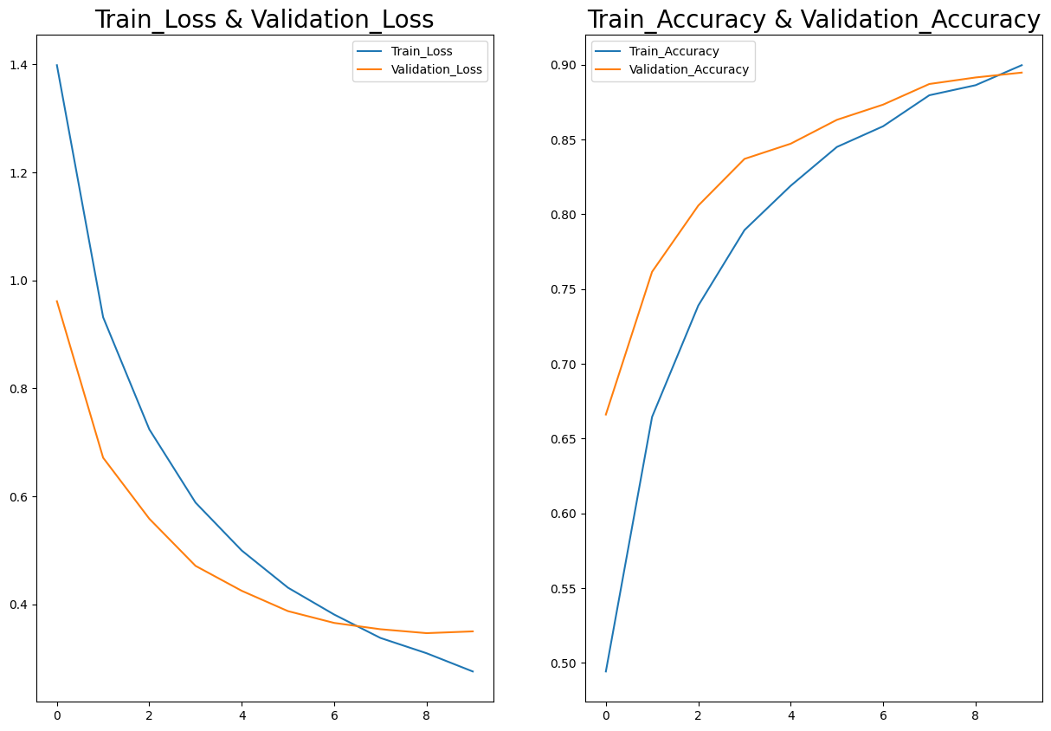

Slide 28
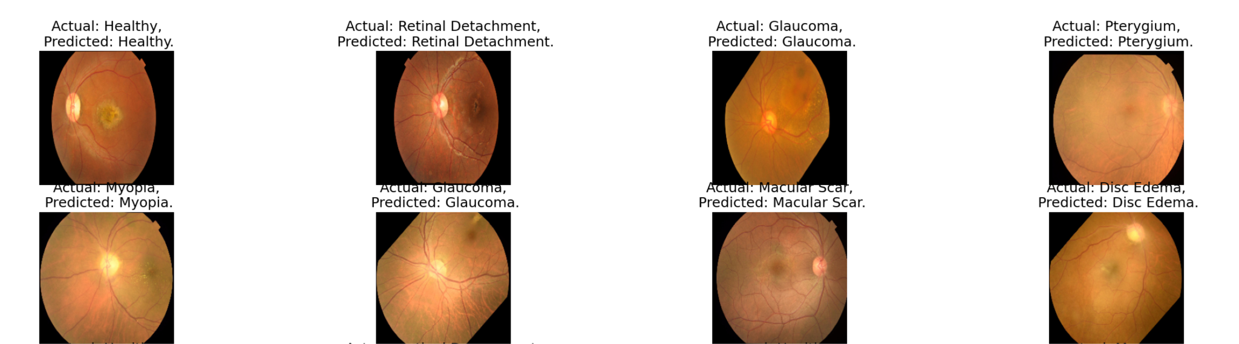
CNN MODEL RESULTS

Slide 29
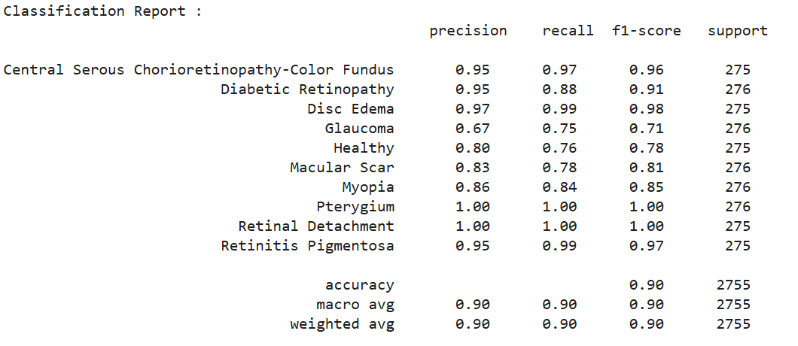
BASELINE CLASSIFICATION REPORT
(Validation Set)

Slide 30
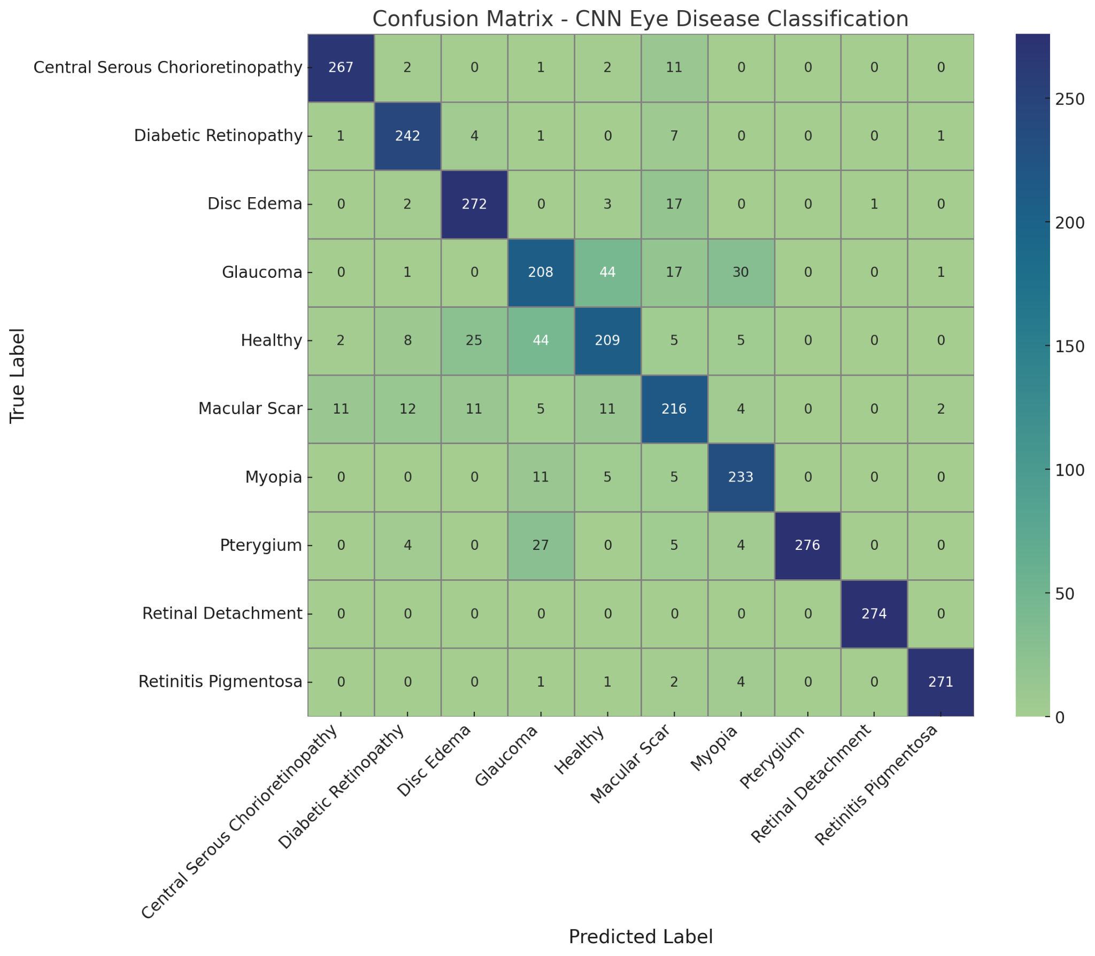
CONFUSION MATRIX

Slide 31
CONFUSION MATRIX
Key Observations
Healthy, Glaucoma, and Myopia are often confused — subtle visual differences.
Pterygium predicted perfectly; very likely overfitting due to few unique images.
Model handles strong visual features well; struggles with mild cases.
Oversampling helped balance training, but minor classes risk memorization.

Slide 32
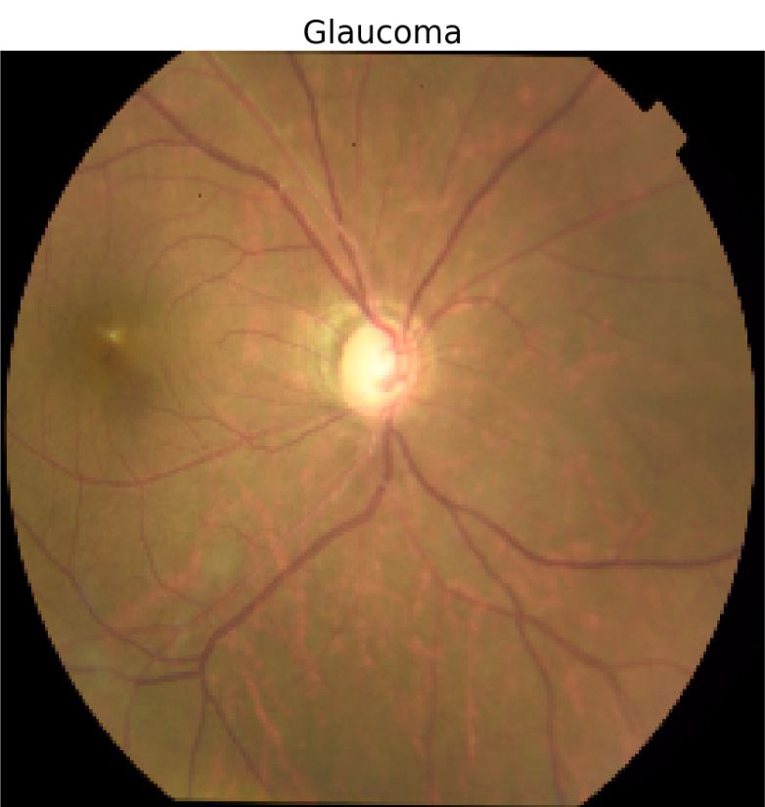
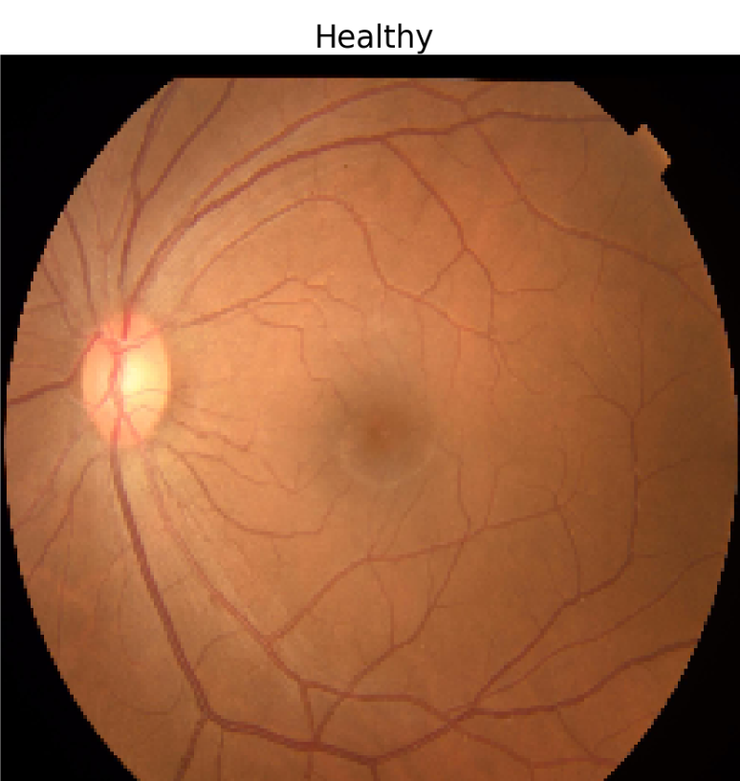
VS
In early Glaucoma, the damage is microscopic, slow, and hidden inside the nerve tissues
Healthy eyes and early-glaucoma eyes both have a normal-looking retina
In advanced glaucoma, the optic cup gets bigger, and the retina and nerves start to thin.

Slide 33
06
CONCLUSION

Slide 34
Key Insights
Effective preprocessing and hyperparameter tuning enabled the CNN to learn key visual patterns and achieve strong overall performance.
Layered convolutional architecture helped the model detect increasingly complex retinal features, contributing to high accuracy on diseases with distinct visual traits.
Balancing the dataset via random oversampling reduced class bias, but may have led to overfitting in underrepresented classes like Pterygium.
While the model performs well overall, further refinement is needed to improve classification of visually similar classes such as Healthy, Glaucoma, and Myopia, which are often confused.

Slide 35
Thank You!
Any questions?

